Slide 1




Your Rights
P1-P3

Slide 2

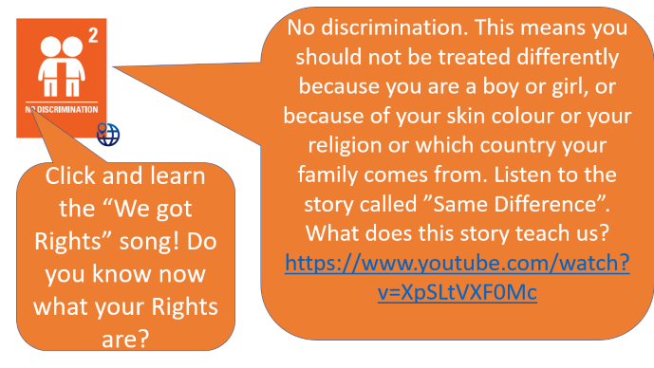
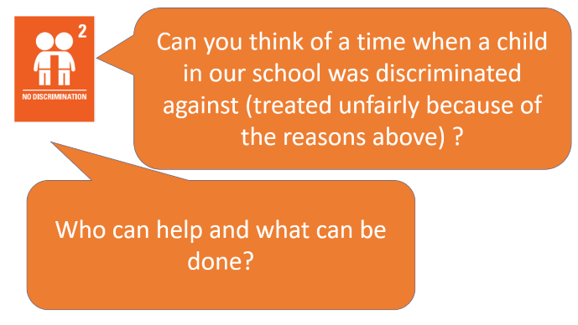
Teacher’s note
Each slide has a Right.
Each slide has discussion points.
Click on the Right when you see the symbol to go to a movie, website or activity which will help the discussion.
You can get help to protect a child’s rights at https://cypcs.org.uk/rights/uncrc/articles/article-2/

Slide 3


Every child has “Rights”. Adults must help us to have all of our Rights.

Slide 4
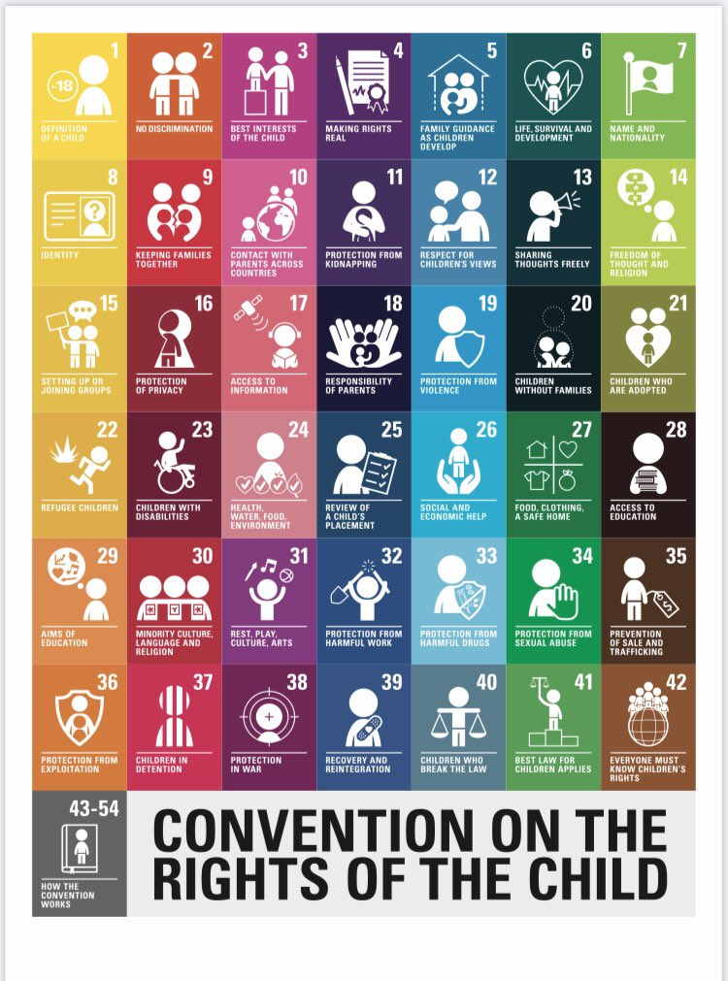

Let’s take a closer look at some of your Rights.

Slide 5


No discrimination. This means you should not be treated differently because you are a boy or girl, or because of your skin colour or your religion or which country your family comes from. Listen to the story called ”Same Difference”. What does this story teach us? https://www.youtube.com/watch?v=XpSLtVXF0Mc
Click and learn the “We got Rights” song! Do you know now what your Rights are?

Slide 6

What do children say about rights?
https://www.youtube.com/watch?v=sAaUYlnGJzk
Every child has the right to see friends, read and watch TV/internet, have privacy. Should adults always decide things for you? Click to watch a movie to get you thinking about this!

Slide 7

Click and watch the movie. Do the children have all of these rights? Do you?
Right to go to school.
Right to play.
Right to good food.
Right to health care.

Slide 8

Click to watch the movie. The children help to look after their mum. Their mum is not well. What rights might the children be missing?
Who could help them get all of their rights?

Slide 9

Every child has the Right to be free and to have their own thoughts. Listen to the story about the donkeys. Which donkey was free and happy? The one with the nice home and food or the one who can go wherever he wants?

Slide 10



Are you able to watch TV, use the internet TV and read books? Does anyone stop you doing this? Why might they want to stop you? Watch the movie about freedoms and laws.
Parents have to be responsibly for our clothes, food, safe home and many other things. But kids can take responsibility for themselves too. Listen to this story. Do you do any of these?

Slide 11


Sometimes when a war happens, children have to leave their country and come to Scotland to be safe. Sometimes the mums and dads cannot escape to come to Scotland. Who could help the boy in this story to see his mum and dad again?

Slide 12


We all find some things hard. Some children might find it hard to read. Some children find it hard to listen. Some children find it hard to walk or talk. If we have a disability it means we might need more help with something. It is important we don’t just see what a child can’t do. It is important we see what a child CAN do! Watch the movie and tell me what the children CAN do. Who helps them?

Slide 13
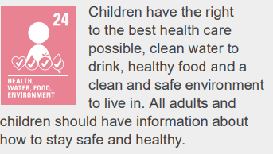

Click to watch the movie. The baby just got new glasses to help her see! Which rights does this support?

Slide 14
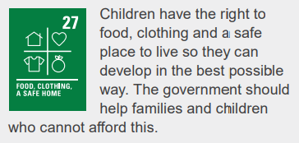
Every child has the right to a safe place to live. Click and listen to the story.

